Slide 1
Olist E-Commerce Data Warehouse & Business Analytics
SQL Server | Medallion Architecture | Exploratory Data Analysis
Team members : Mariam Atef - Joya Sabry - Rewan Khaled
Ekramy Rabie - Mostafa Hamdy - Mohamed Khaled
· Instructor: kholoud Ali

Slide 2
From raw commerce data to business analysis
01
02
03
04
05
Source e-commerce data and sales-related tables
Build the SQL Server data warehouse
Process data through Bronze, Silver, and Gold layers
Answer business questions with SQL-based exploratory analysis
Develop the interactive dashboard next
Completed through EDA; dashboard remains in progress.
02

Slide 3
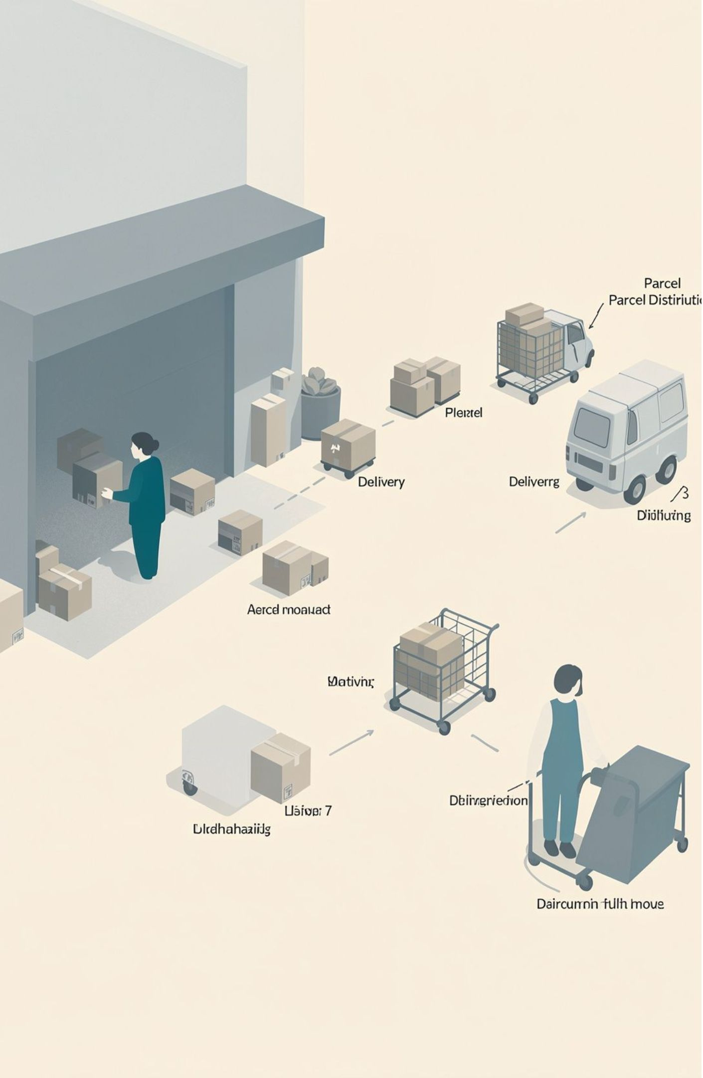
Business decisions need a reliable view of commerce performance
Track sales performance and order trends
Understand delivery performance and delays
Compare product categories and sellers
Evaluate geographic concentration and freight costs
Monitor order cancellations and incomplete delivery information
Objective: transform raw e-commerce data into structured, reliable, business-oriented insights that support decision-making.
03

Slide 4

The dataset connects sales, orders, products, sellers, and delivery
The analysis uses sales-related information including order status, sales amounts, freight values, product categories, seller locations, and delivery dates.
Sales
Orders
Aggregated revenue metrics that inform Orders and Products insights.
Transaction records linking Sales with Products and Delivery status.
Products
Sellers
Catalog details that influence Sales trends and Seller offerings.
Vendor profiles coordinating product availability and fulfillment.
04

Slide 5




The warehouse turns business events into analytical context
Fact tables
Dimension tables
SQL analysis
Verified analysis source
measurable business events such as sales and orders
descriptive context for analysis, where applicable
structured queries that aggregate and compare business performance
dbo.sales_copy, described as a copy of gold.fact_sales
Keep all other schema details editable and unclaimed.
05

Slide 6

Medallion Architecture creates a path from raw data to insight
Bronze Layer
Silver Layer
Gold Layer
These are standard architecture purposes; do not claim unconfirmed transformations, joins, validation rules, or implemented tables.
06

Slide 7
Fourteen business questions structure the EDA
Sales trends and order value
Order status and delivery performance
Freight cost analysis
Product category performance
Seller and geographic performance
Late-delivery and cancellation analysis
Business Question → SQL Query → Aggregated Results → Business Insight
07

Slide 8
Delivered orders generated 13,221,498.11 in reported sales
98,666
96,478
97.78%
total distinct orders
delivered orders
delivered-order rate
13,221,498.11
137.04
total delivered sales
average delivered order value
987,765.37
Monthly delivered-sales trend
peak monthly delivered sales in November 2017, across 7,289 orders
Insert monthly delivered-sales series from workbook
08

Slide 9
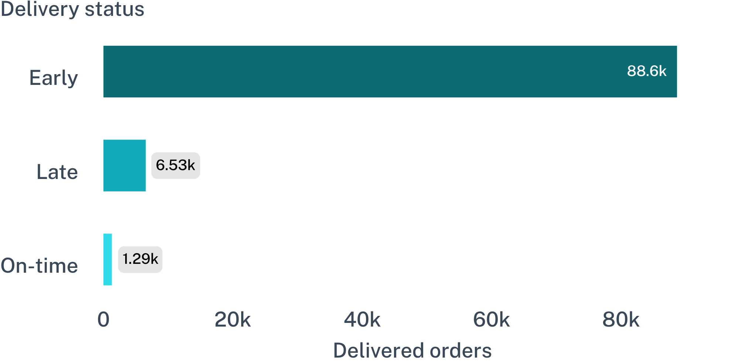
Most delivered orders arrived early, but late deliveries remain visible
Average delivery time
12.47 days
Range: 0.53–209.63 days; the maximum may represent an outlier
Approximately 92% arrived early and 6.8% arrived late
19.95 average freight value for delivered rows
09

Slide 10
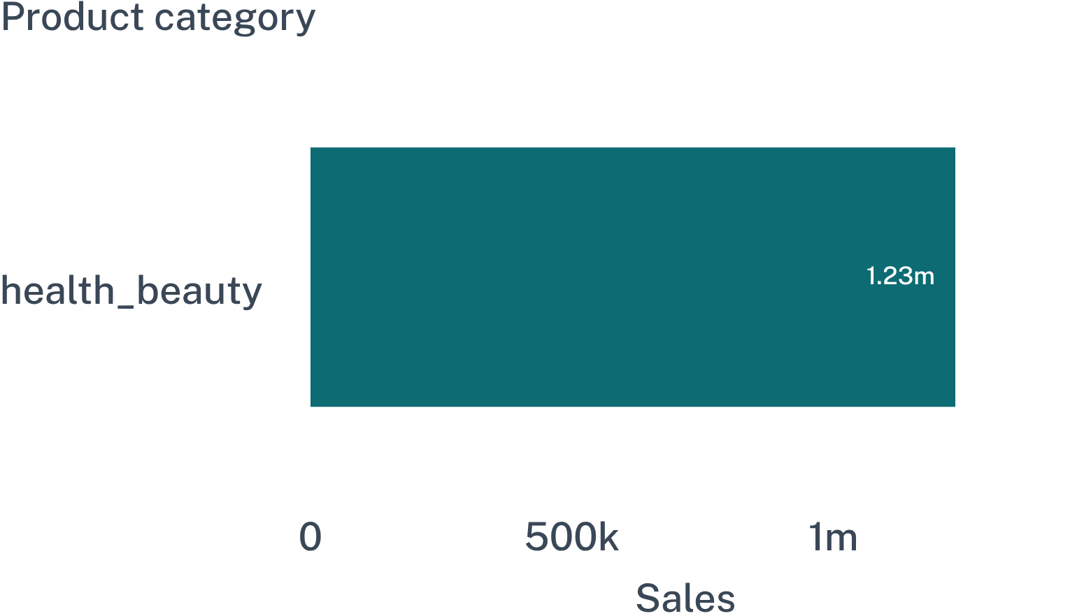
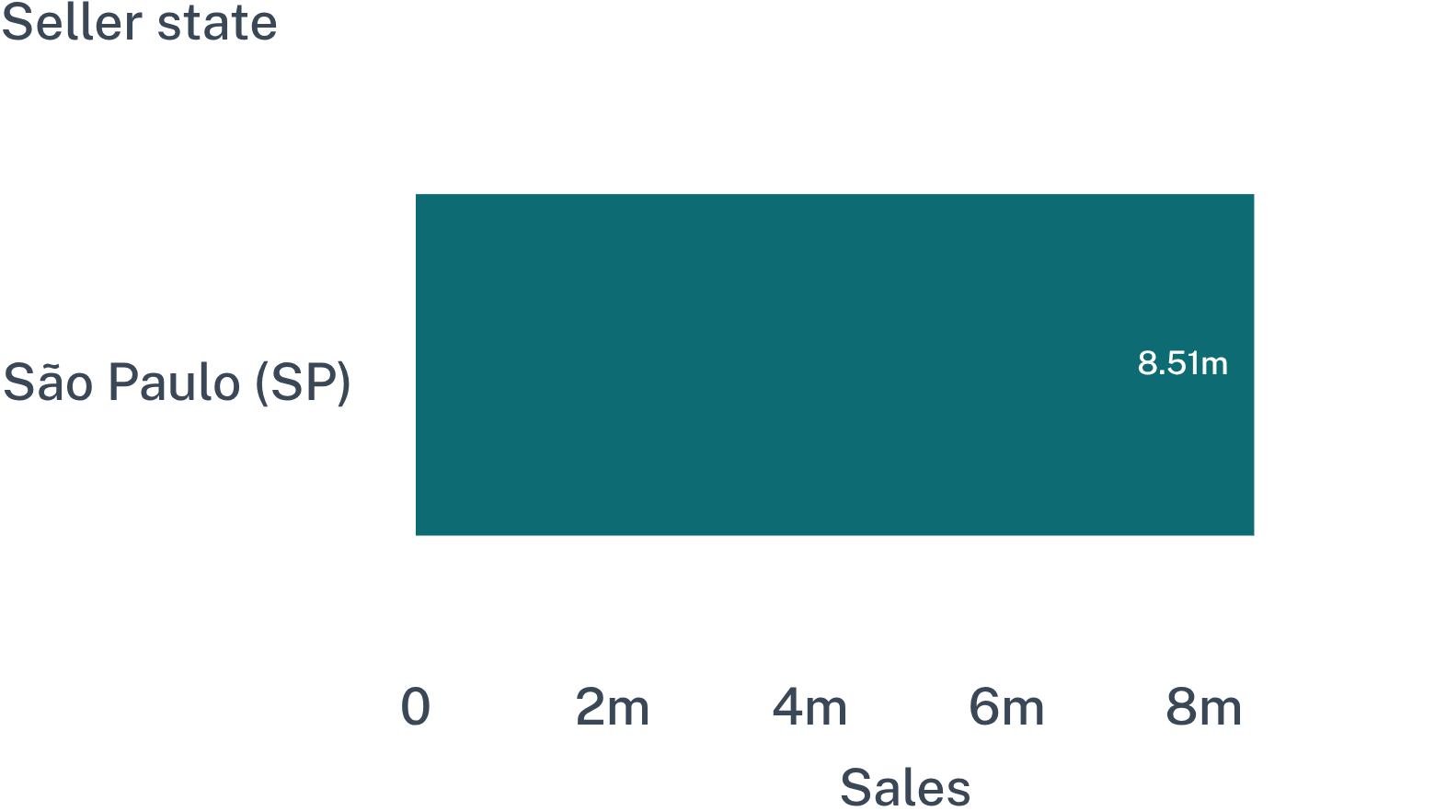
Sales concentrate in health_beauty and São Paulo
Product category performance
Seller-state performance
bed_bath_table: highest order count among the listed categories at 9,272 orders
Seller key 858: top seller at 226,987.93, located in Guariba, SP
9 of the 10 highest-sales sellers are located in SP
Insert missing comparison values from workbook
10

Slide 11
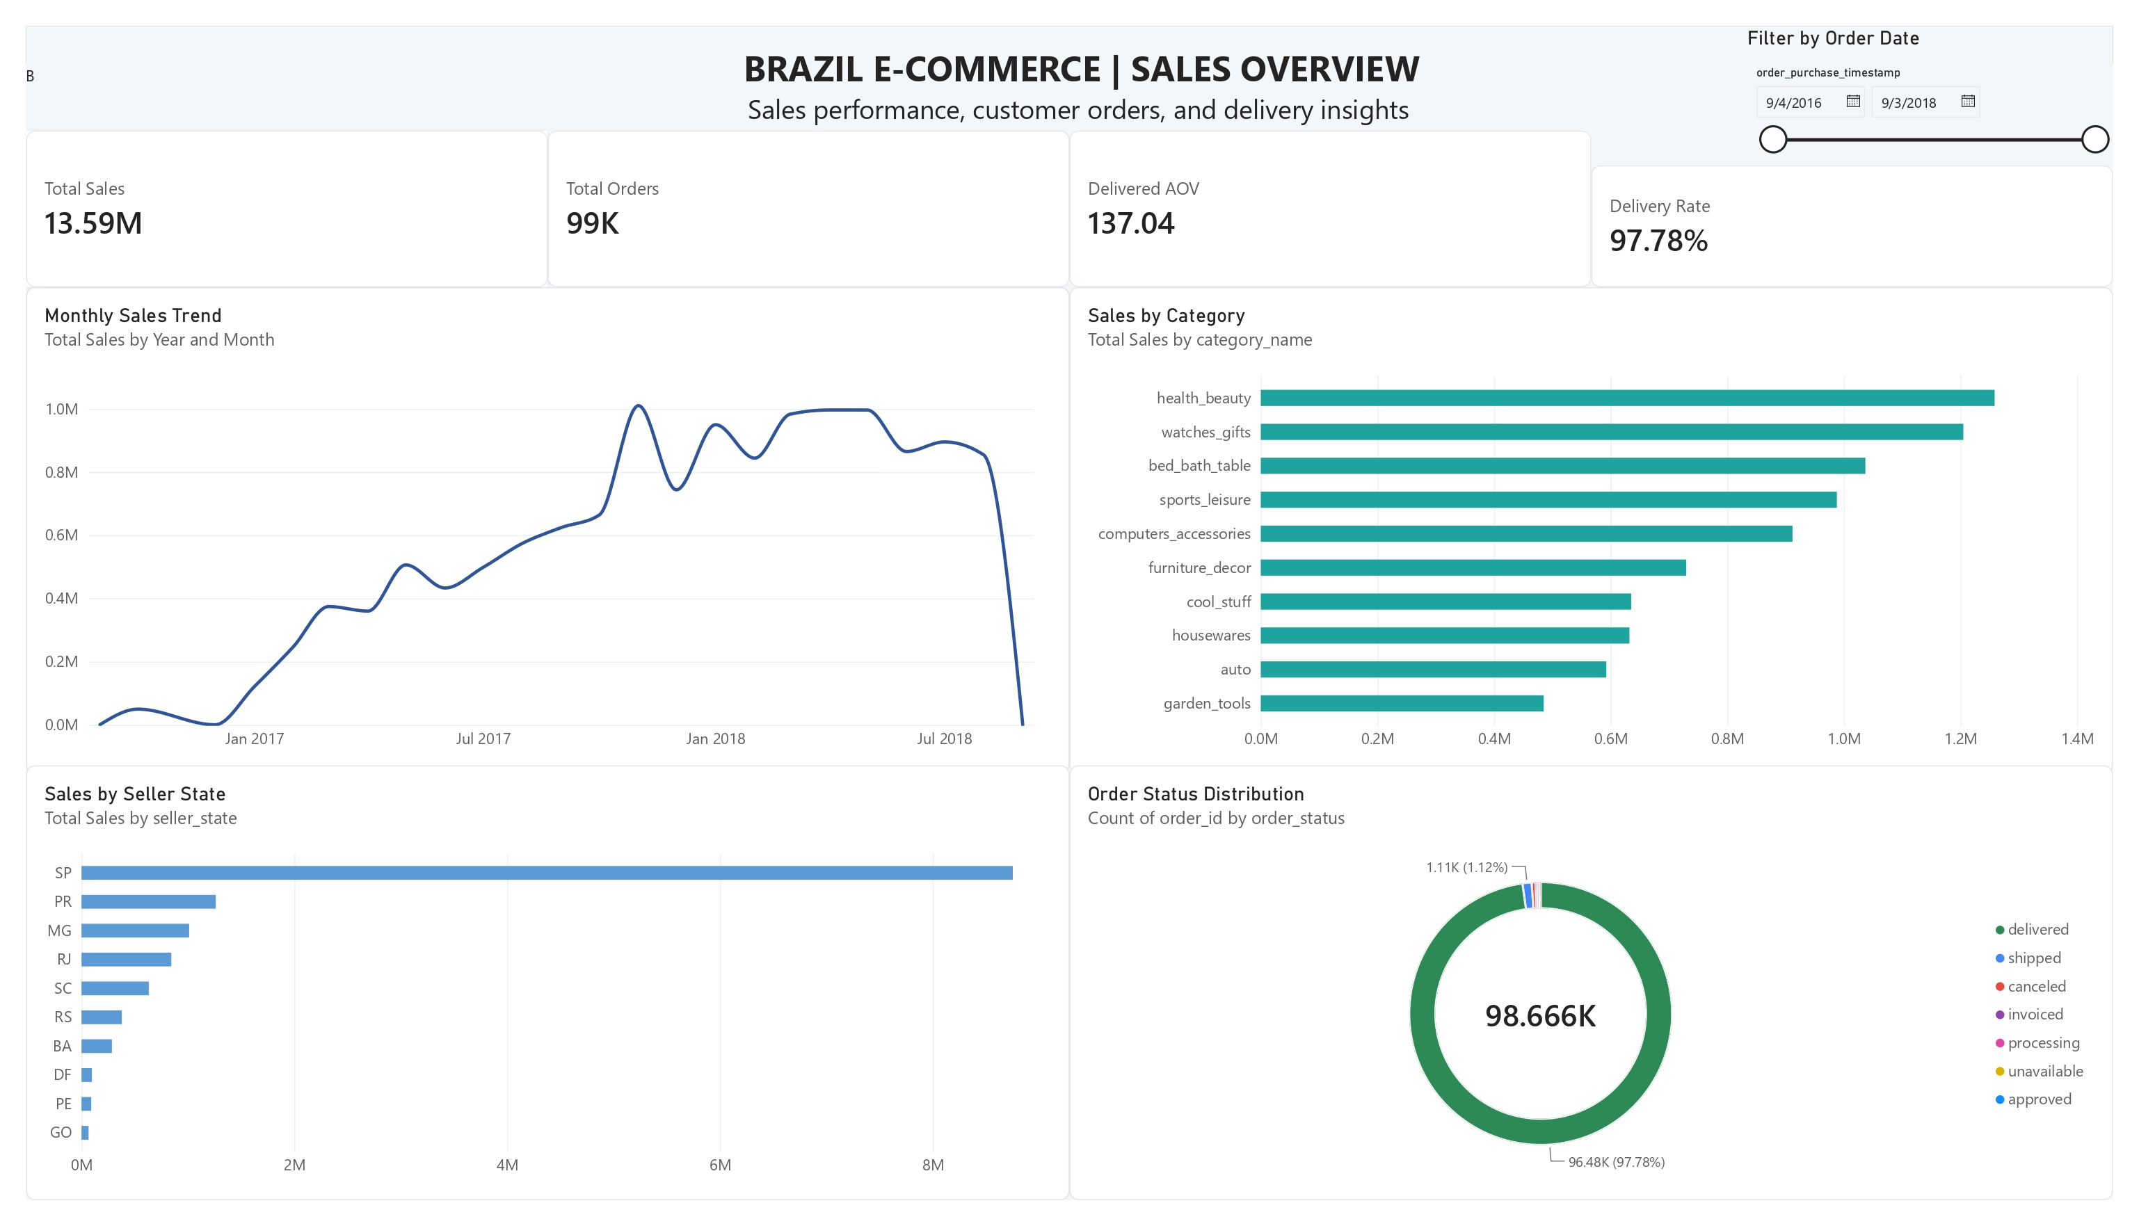
Dashboard

Slide 12
Thank You

